Slide 1
Bike-Sharing Rental
Project Members
S. Tarun

Slide 2
Agenda
Abstract
Introduction
Libraries Used
Exploratory Data Analysis
Data Visualization
Correlation Between Features
Feature Engineering
Model Building
Model Deployment

Slide 3
Abstract
This project aims to develop a machine learning model to predict bike rental demand in urban areas. By analyzing historical data, including weather conditions, seasonality, holidays, and other relevant factors, the model will provide valuable insights into future demand patterns. This information will be crucial for bike-sharing companies to optimize their operations, improve customer satisfaction, and achieve sustainable growth. The project will involve data exploration, feature engineering, model selection, hyperparameter tuning, and model evaluation using appropriate metrics. The final model will be deployed using Streamlit for easy accessibility and real-time predictions.

Slide 4
Introduction
Bike-sharing systems have emerged as a popular and sustainable mode of transportation in urban areas, offering convenient and affordable access to bicycles. However, effectively managing the supply and demand of rental bikes is crucial for the success of such systems. Inaccurate demand forecasting can lead to situations where bikes are unavailable when demand is high, resulting in frustrated customers and lost revenue. Conversely, an oversupply of bikes can lead to unnecessary costs and inefficient resource utilization.
This project seeks to address this challenge by developing a predictive model that can accurately forecast bike rental demand. By leveraging historical data and incorporating relevant external factors, the model will provide valuable insights into future demand patterns. This information can be used by bike-sharing companies to make informed decisions regarding bike distribution, pricing strategies, and marketing efforts.
The proposed solution involves a comprehensive approach that encompasses data exploration, feature engineering, model selection and training, hyperparameter tuning, model evaluation, and deployment. The use of Streamlit will enable easy accessibility and real-time predictions, making the model a valuable tool for operational decision-making.

Slide 5
Libraries Used
Pandas: A powerful library for data manipulation and analysis, offering easy-to-use data structures like Data Frames to handle structured data efficiently.
Matplotlib: A versatile plotting library for creating static, animated, and interactive visualizations in Python.
Seaborn: Built on top of Matplotlib, it provides a high-level interface for creating visually appealing and informative statistical graphics.
Scikit-learn: A robust library for machine learning, offering tools for tasks like classification, regression, clustering, and model evaluation.
Pickle: A standard Python library for serializing and deserializing Python objects, enabling them to be saved to files or transmitted over networks.

Slide 6
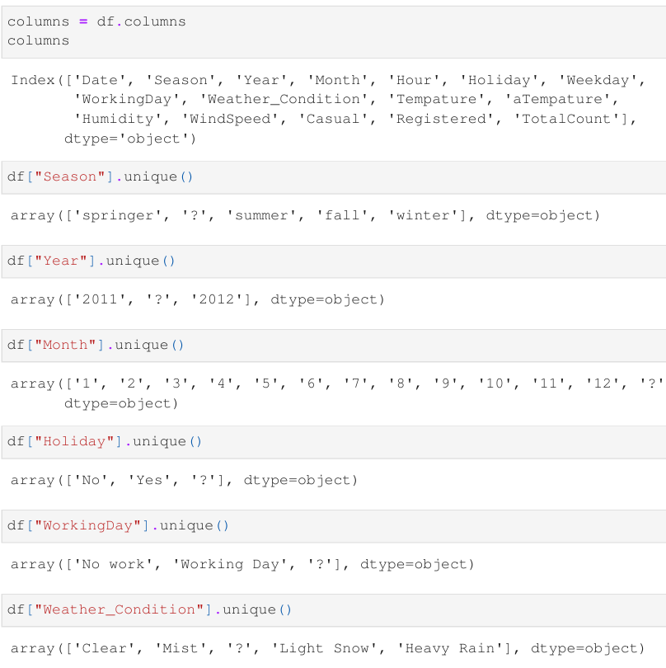
Exploratory Data Analysis EDA
As we can see, some features in the dataset contain the '?' symbol.
Cells containing '?’ symbol are removed and replaced with empty values. Subsequently.
Handle Missing Values: Detect Missing Values and Apply Appropriate Imputation Techniques.
All numerical features are filled with the mean of their respective feature, while categorical features are filled with random values from their respective feature.

Slide 7
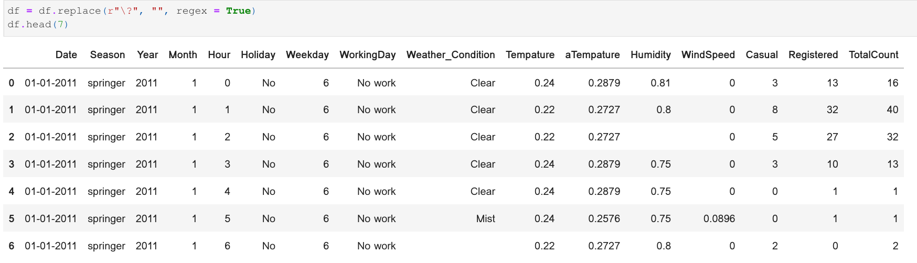
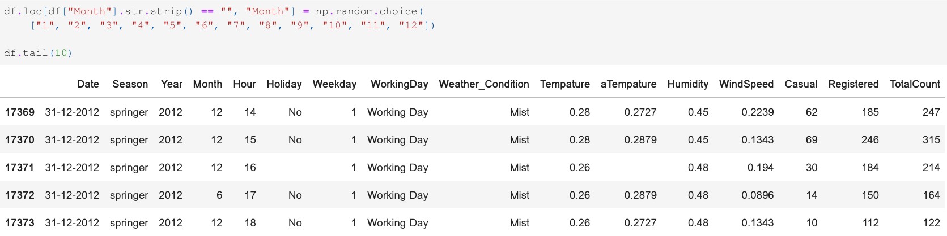

Slide 8
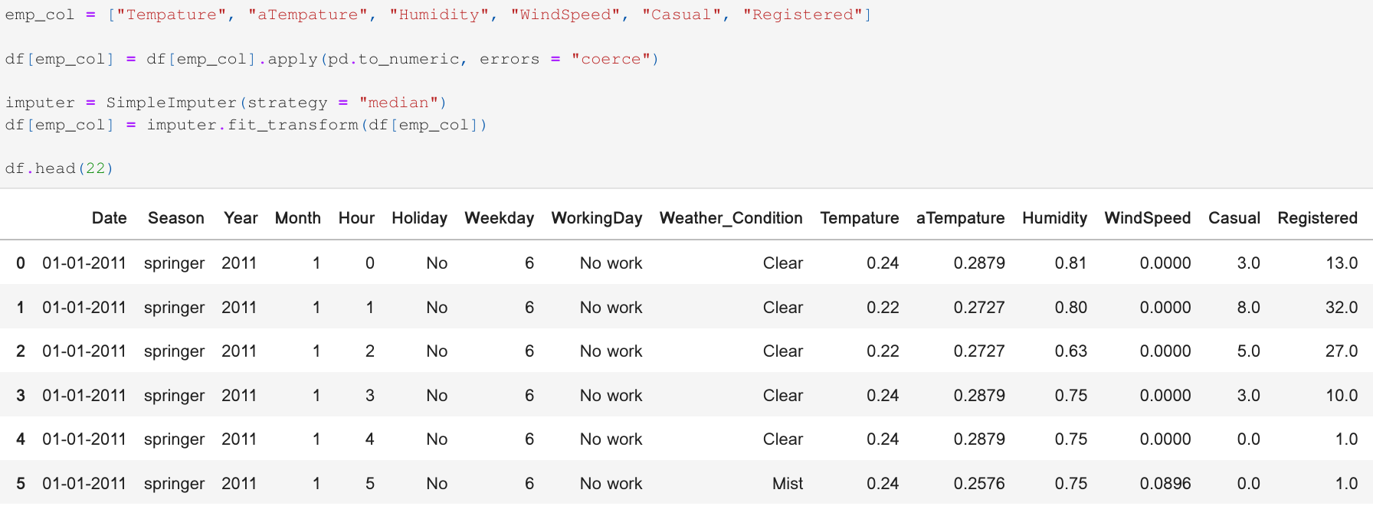

Slide 9
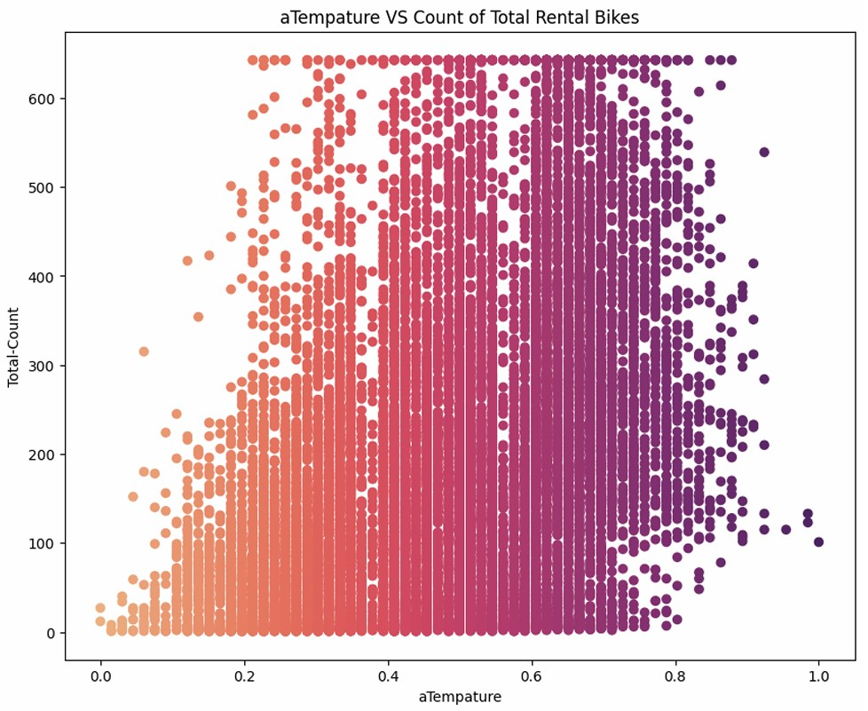
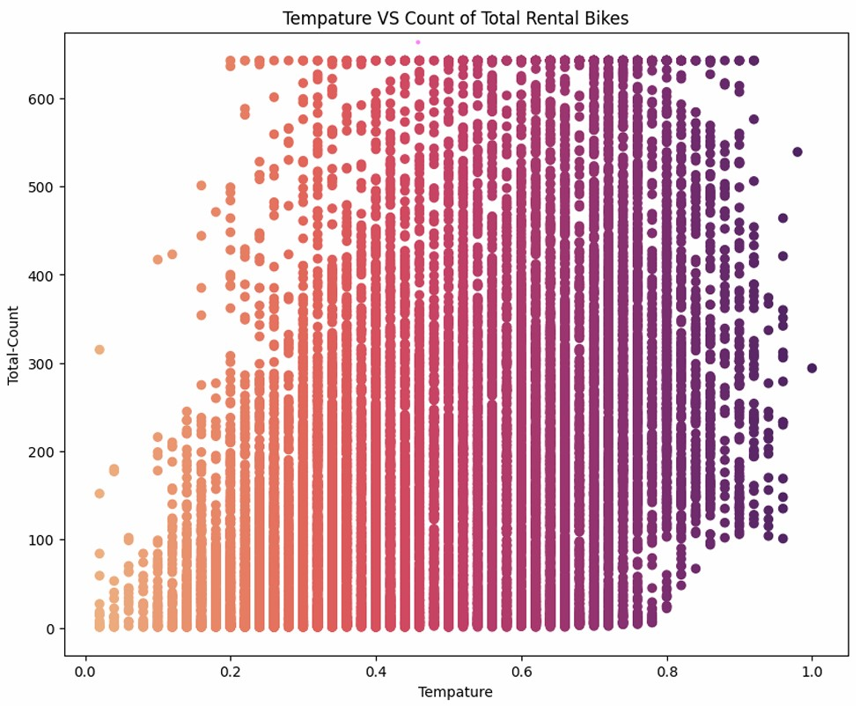
Data Visualization Both images indicate a lower count when Temp and a-Temp values were either extremely low or extremely high.

Slide 10
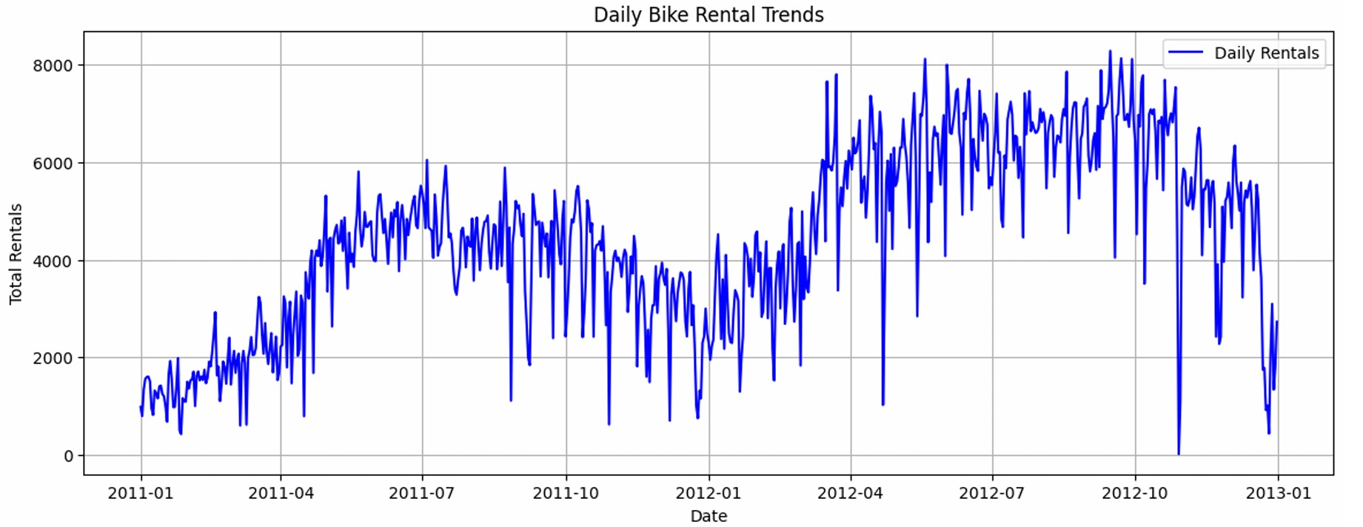
Overall trend: The number of daily rentals seems to have increased over the two-year period.
There are some fluctuations, but the general direction is upwards.
Seasonality: There appears to be some seasonality in the data, with peaks and troughs occurring at regular intervals. This could be due to factors like weather, holidays, or special events.

Slide 11
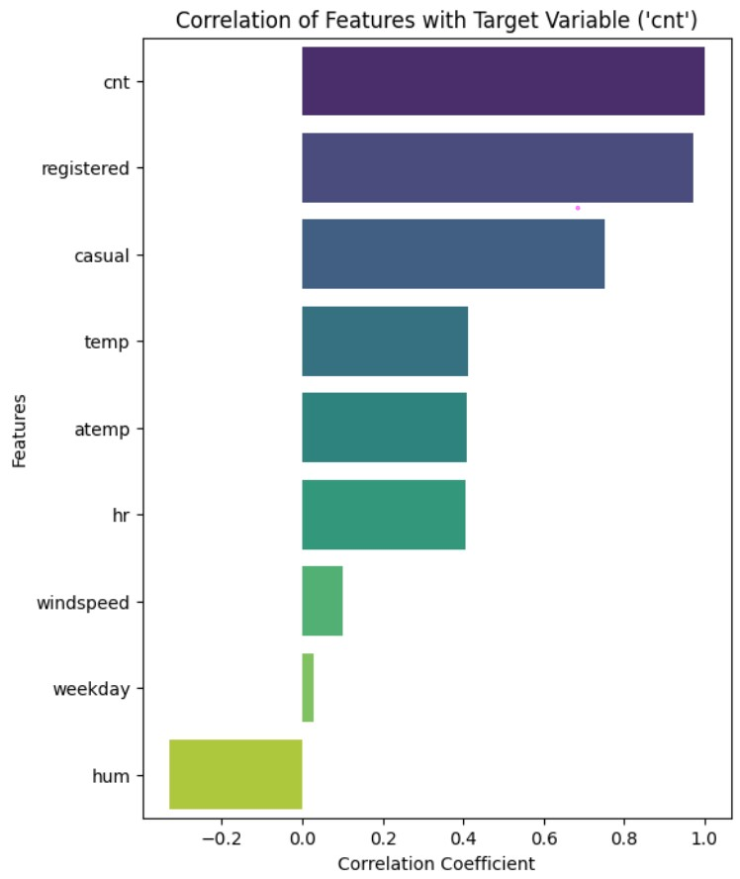
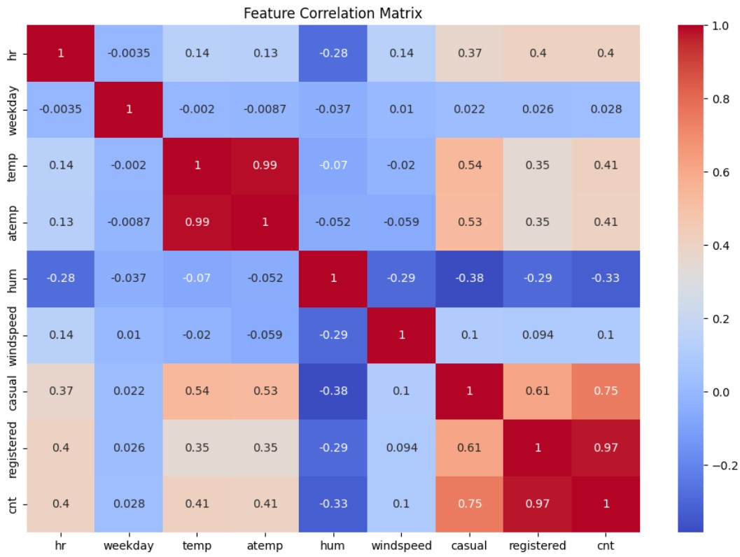
Correlation Between Features
Registered is more correlated with the target variable compared to all other features, and Weekday has the least Correlation among all Positive Correlations.
Humidity has a Negative Correlation.

Slide 12
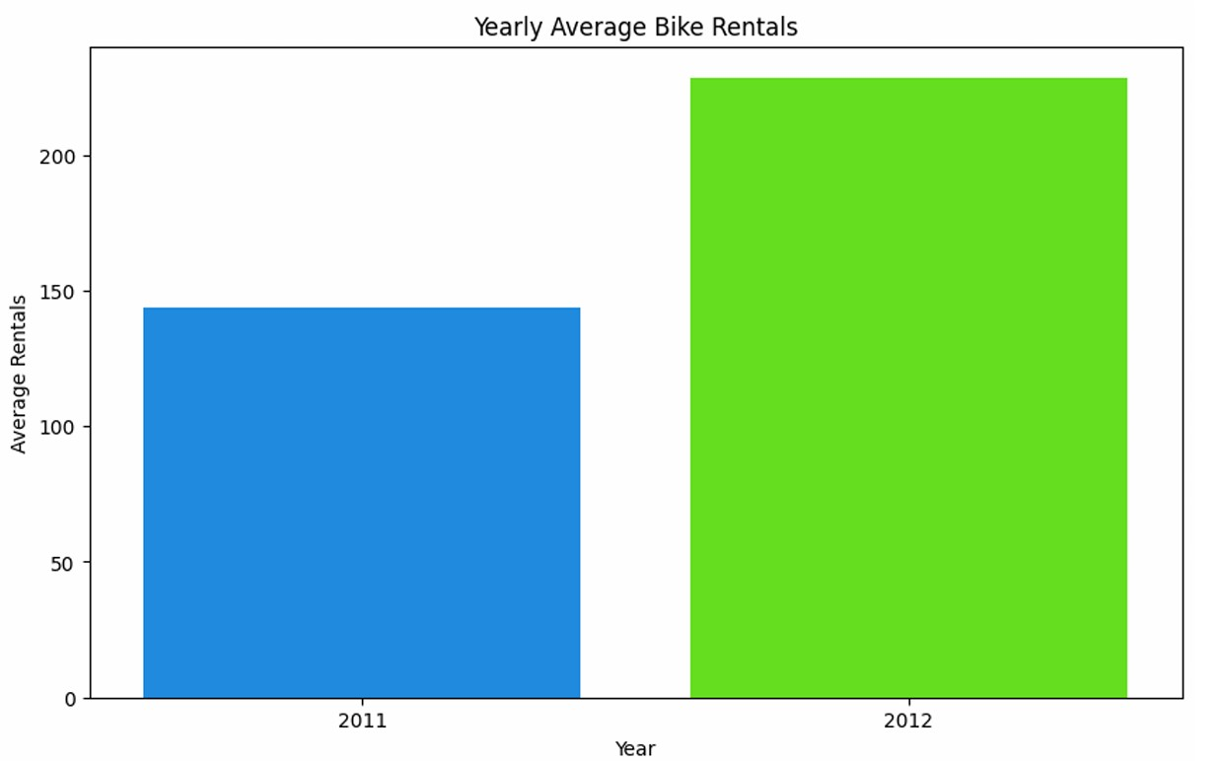
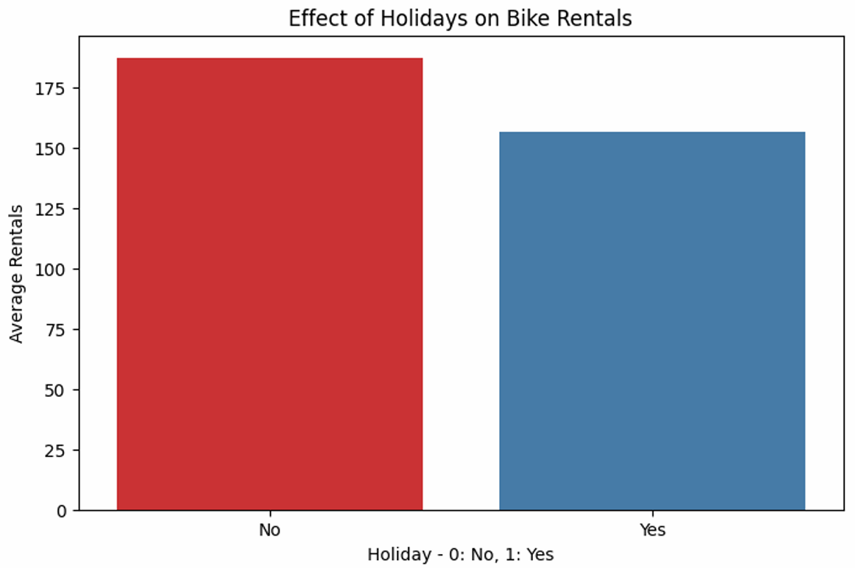
Bar Plot As we can see, the Average Sales of Bike Rentals in 2012 were higher than in 2011. Most people likely used Bike Rentals more frequently on Working Days or Non-Holidays.

Slide 13
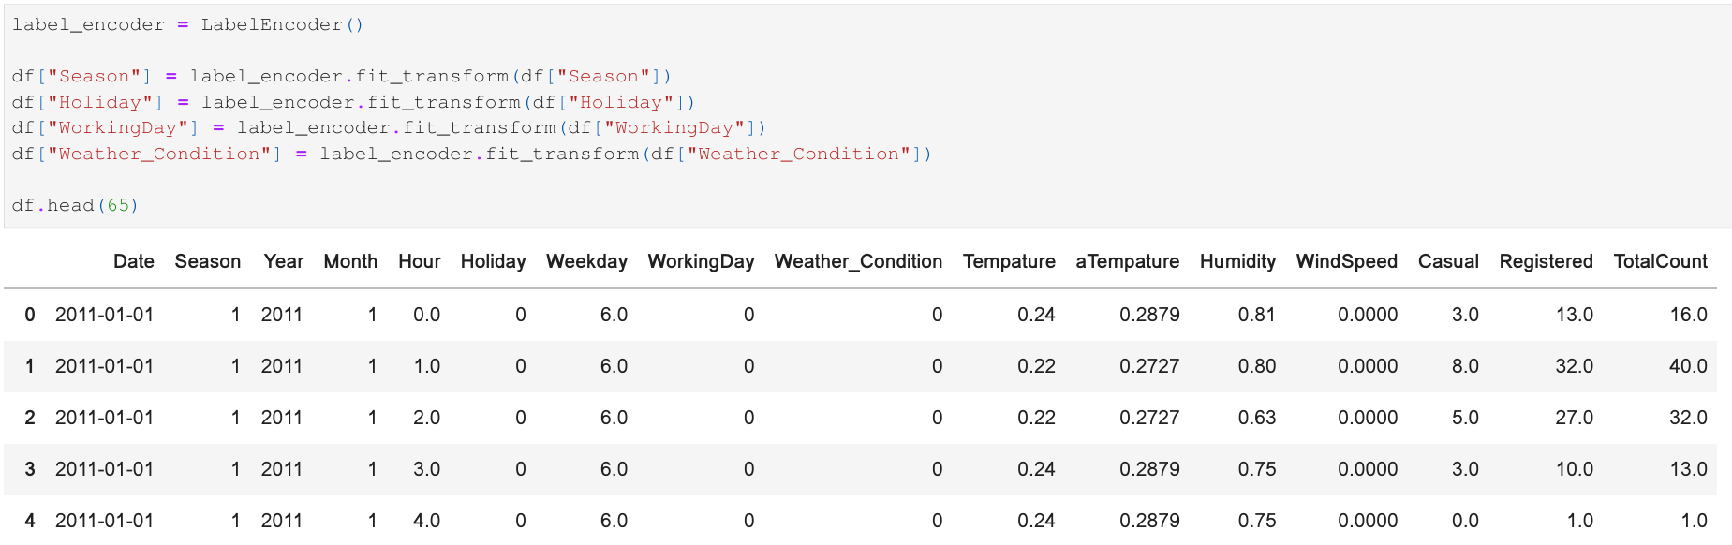
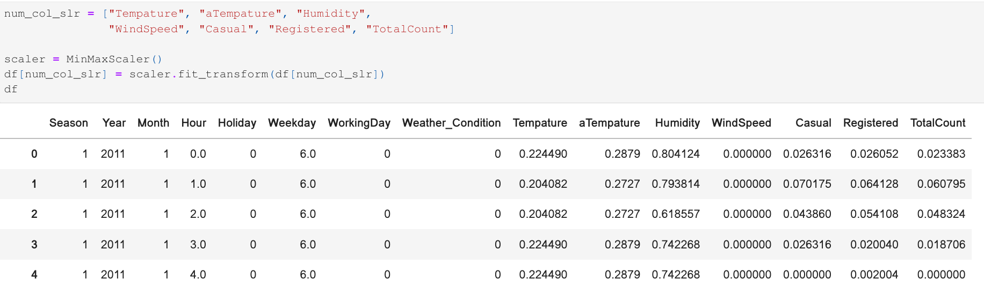
Feature Engineering Label Encoding & Scaling

Slide 14
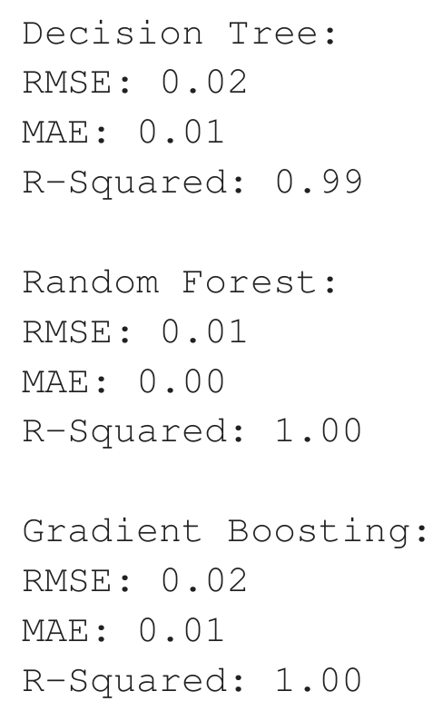
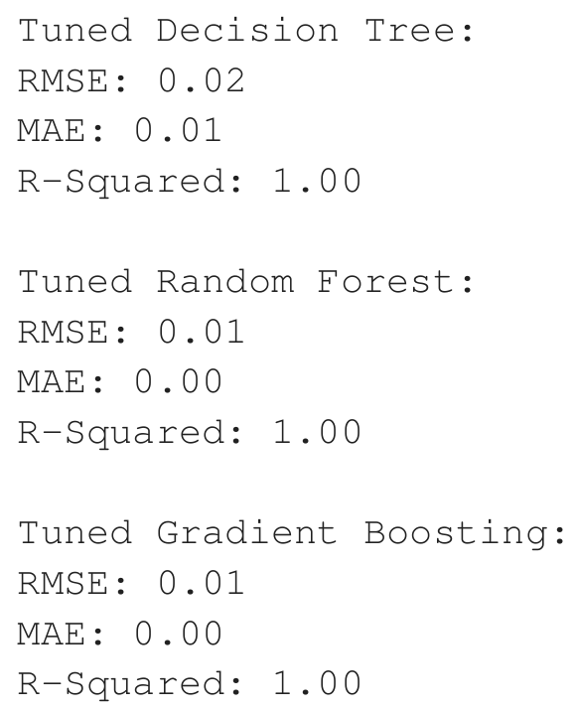
Model Building After evaluation based on RMSE, MAE, or R-squared Metrics, the Random Forest Regressor identified as the Best Performing Model. Hyperparameter Tuning Hyperparameter Values using Cross Validation Techniques.

Slide 15
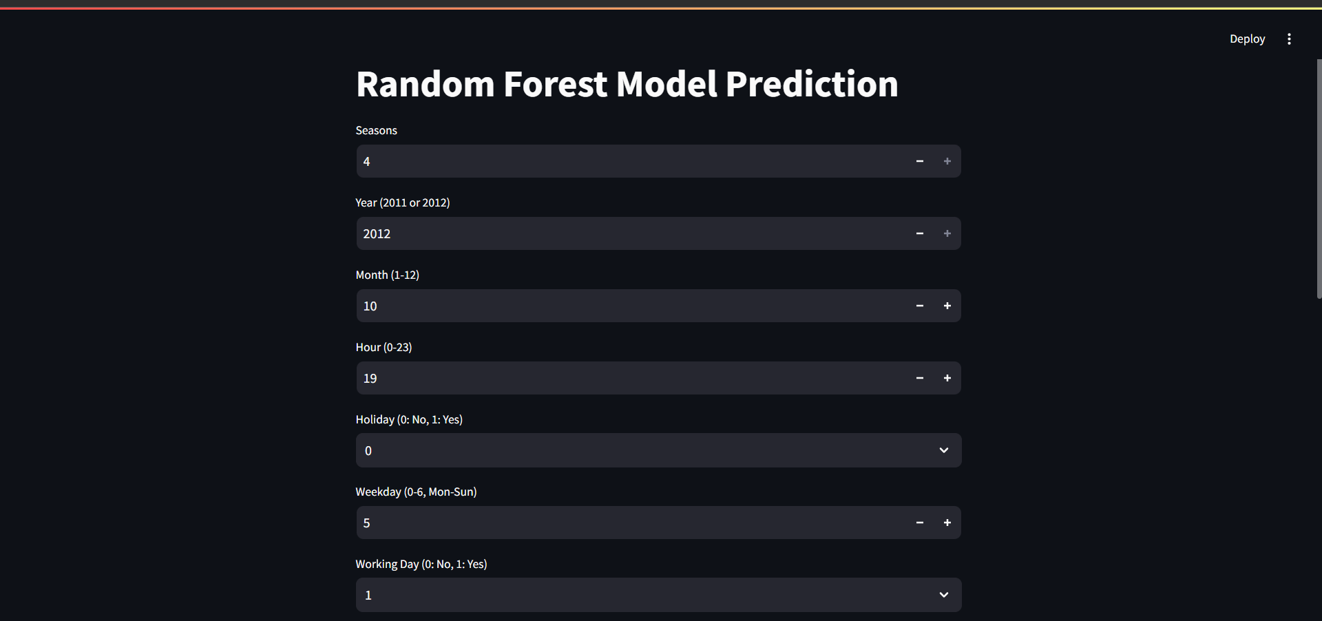
Model Deployment Stream-lit

Slide 16
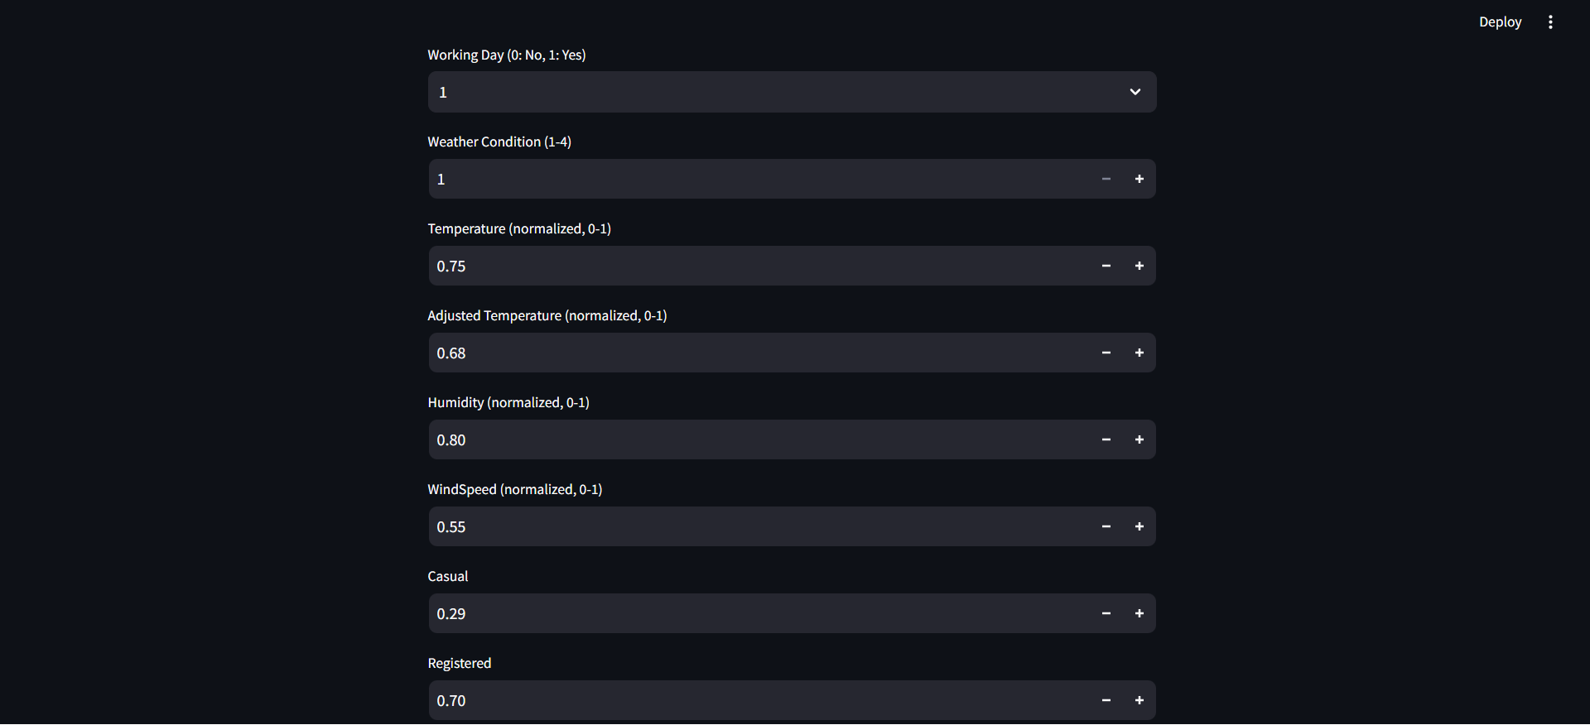

Slide 17
